Slide 1
Big-Kid Rockets
Even more fun than when we were kids!
http://www.free-powerpoint-templates-design.com

Slide 2
Different Rocket Classes
Rockets have come a long way since scouts & schoolyards.
Low Power
Motors ¼A - D Simple Streamer / Parachute Cardboard, Plastic, Glue
Mid/High Power
Motors: E and higher Delayed Deployment Fiberglass, Epoxy

Slide 3
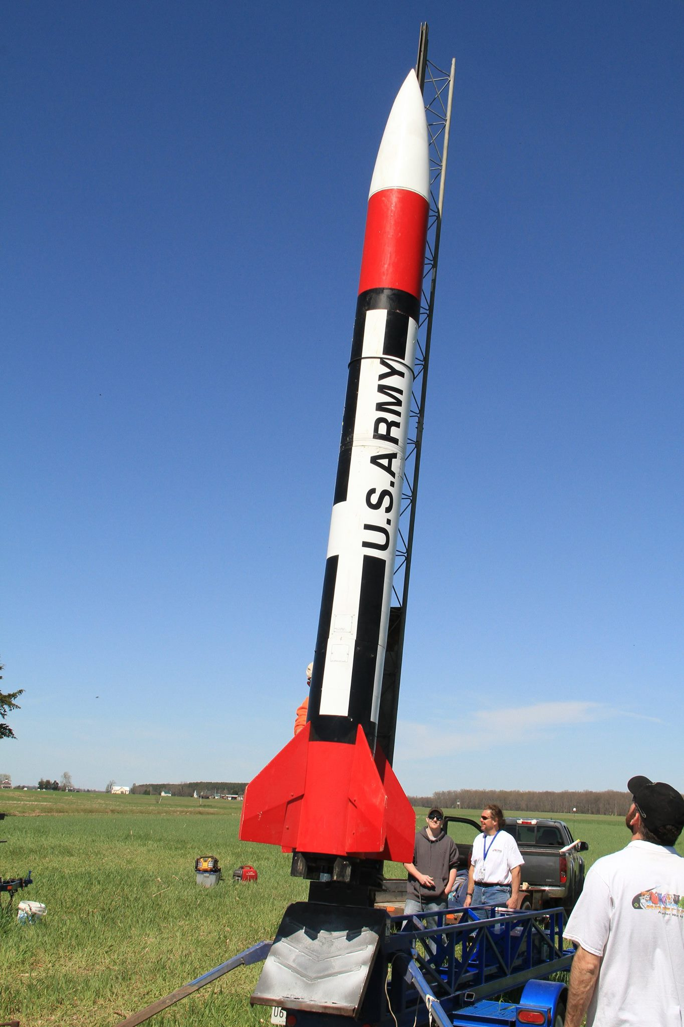
How Big Are These Toys?
How much are you
willing to spend?
Image: Dan Michael, Facebook (https://www.facebook.com/photo?fbid=10208701452241215)

Slide 4
Engine Classifications
Classification | Impulse Range | Impulse Limit (N-s) | Category
Model Rocket | A | 2.5 | Low Power
 | B | 5
 | C | 10
 | D | 20
 | E | 40 | Mid Power
 | F | 80
 | G | 160
High Power (Certification Required) | H | 320 | Level 1
 | I | 640
 | J | 1280 | Level 2
 | K | 2560
 | L | 5120
 | M | 10240 | Level 3
 | N | 20480
 | O | 40960
My Favorite
Fun
Affordable
No certifications

Slide 5
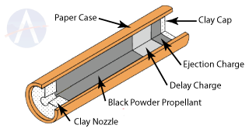
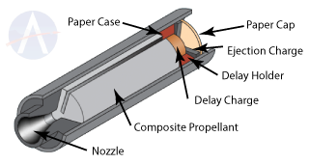
Evolution: Engines
Black Powder
Composite
Cheap but volatile
Low energy density
Basically a firework
Reloadable options
High energy density
Basically a Shuttle booster
Images: Apogee Rockets (https://www.apogeerockets.com/Rocket-Motor-Basics-Quick-Start-Guide)

Slide 6
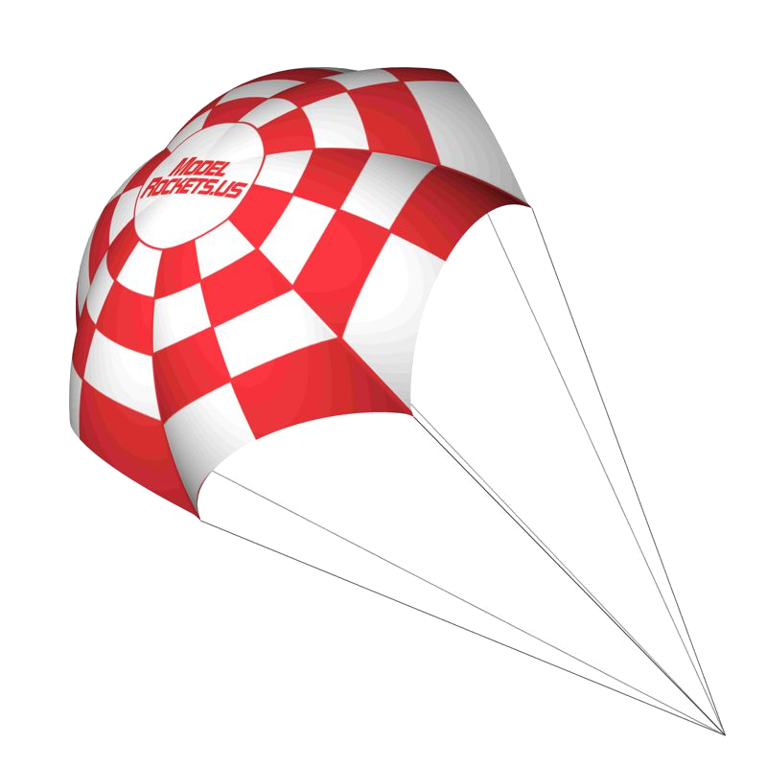
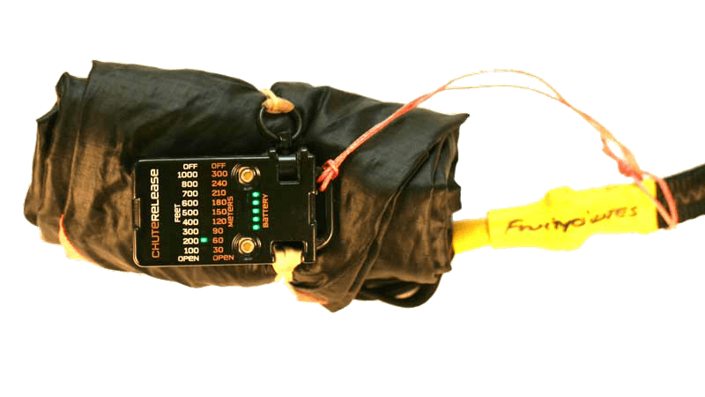
Evolution: Recovery
Simple Parachute
Delayed Release
Deploys at peak altitude
Long walks on windy days
Very reliable
Later altimeter-based deployment
Shorter walks; lose less rockets
...unless they crash ¯\_(ツ)_/¯
Image: ModelRockets.us
Image: Jolly Logic (https://jollylogic.com/products/chuterelease/)

Slide 7
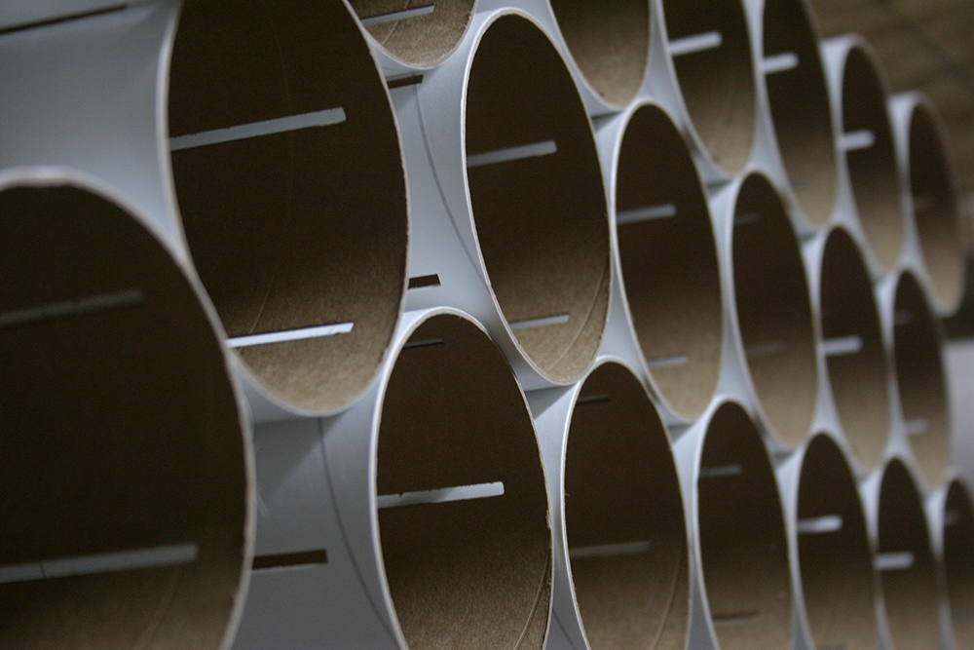
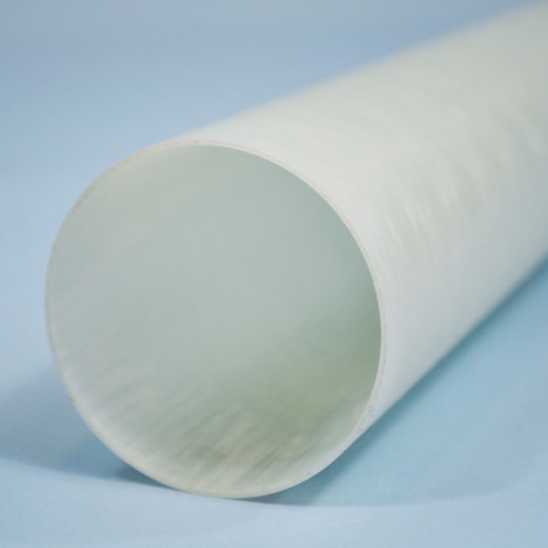
Evolution: Materials
Cardboard & Glue
Fiberglass & Epoxy
Cheap
Easy to work with
Mach capable… sometimes
Strong
Messy
Capable of high mach
Image: LOC Precision (https://locprecision.com/product/slotted-cardboard-airframes/)
Image: Apogee Rockets (https://www.apogeerockets.com/Building-Supplies/Body-Tubes/Fiberglass-Tubes/)

Slide 8
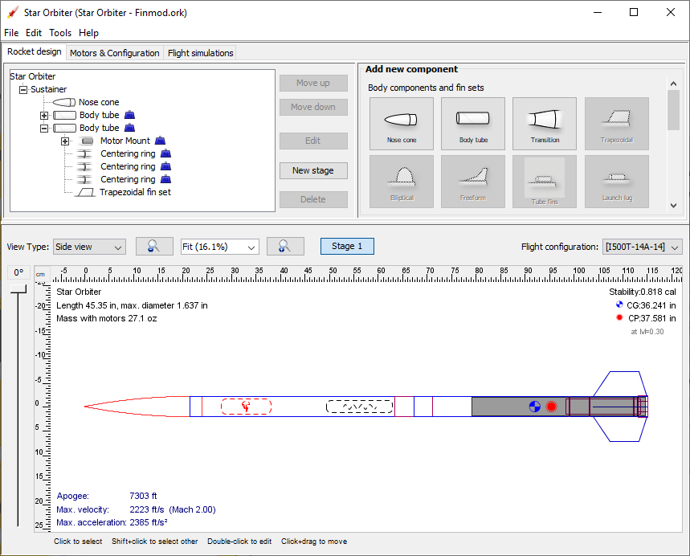
Evolution: Software
Model safety (stability, speed off pad, speed at deployment, etc.)
Model altitude & drift
Choose the right engine

Slide 9
Rocketry Associations
There are 2 major rocketry associations in the USA
National Association of Rocketry
nar.org
195 Chapters $5M Insurance Limit Commercial Motors Only Great for Beginners
Tripoli Rocketry Association
tripoli.org
123 Prefectures $3M Insurance Limit Experimental Motors Allowed Great for Bigger Toys

Slide 10
Thank You
And Happy Flying

